Slide 1
Transposable element expression in the human thymus

Slide 2
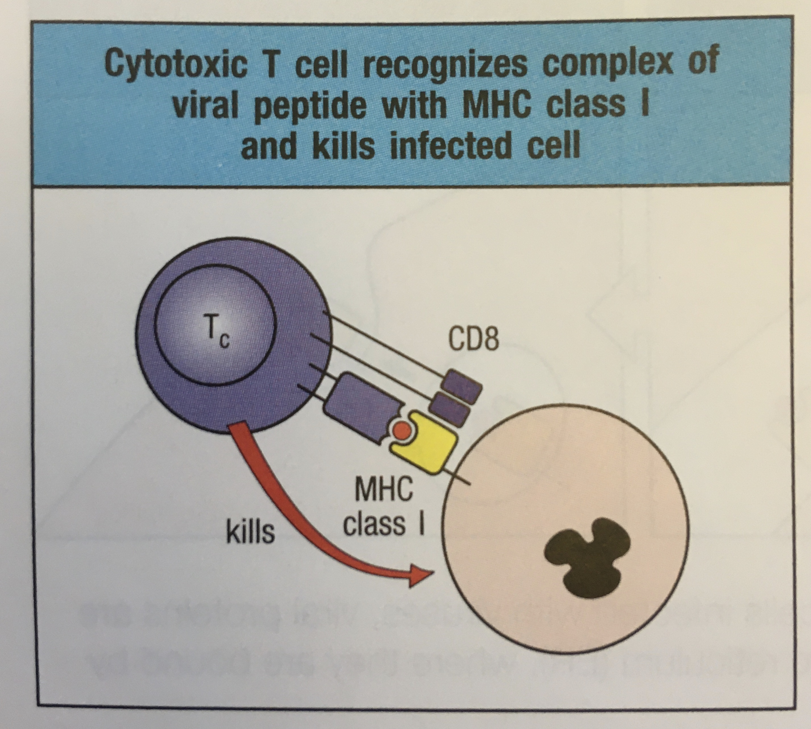
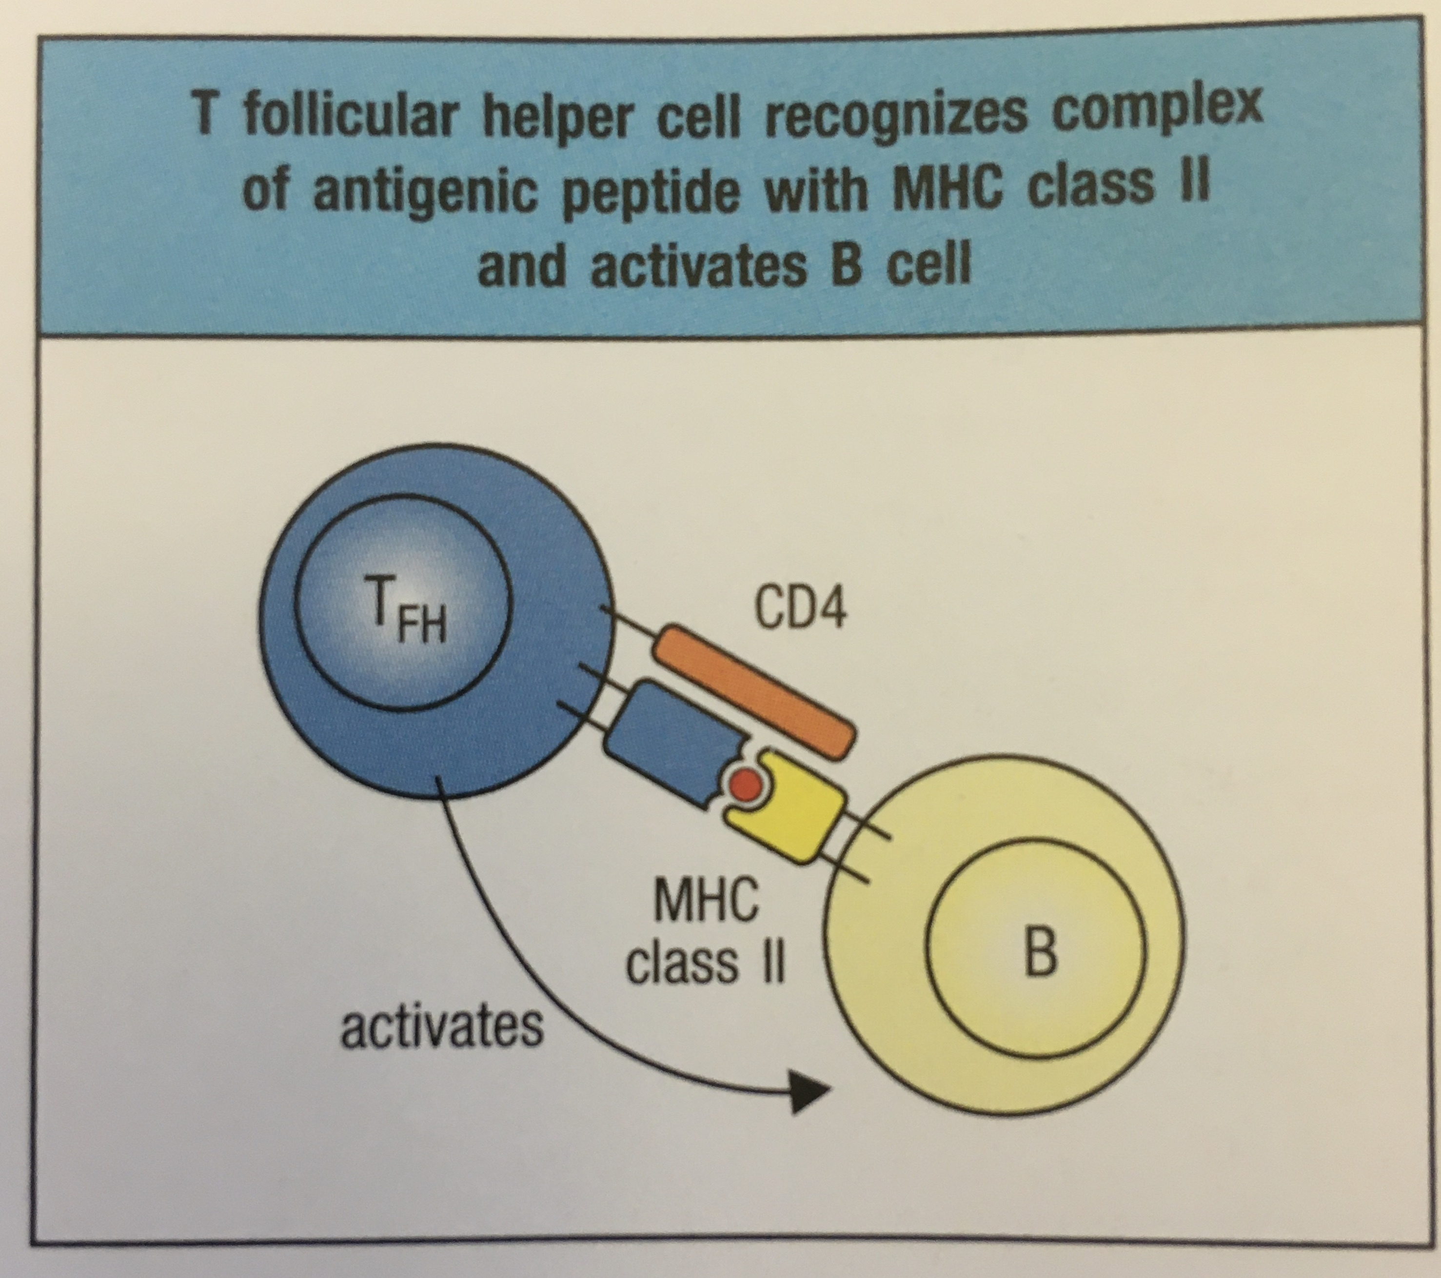
Thymocytes (T-cells) recognize foreign antigens via their surface receptors
Immunobiology 9th Edition, Garland Science (2017)
Notes:
Thymocytes (T-cells) are an arm of the adaptive immune system that recognize foreign antigens via their surface T-cell receptors (TCRs).
Antigens are presented by MHC complexes on the surface of most cells (class I) or APCs (class II). Upon recognition of its cognate antigen, the T-cell initiates a response, either by direct cell death (CD8+) or activation of other lymphocytes (CD4+).

Slide 3
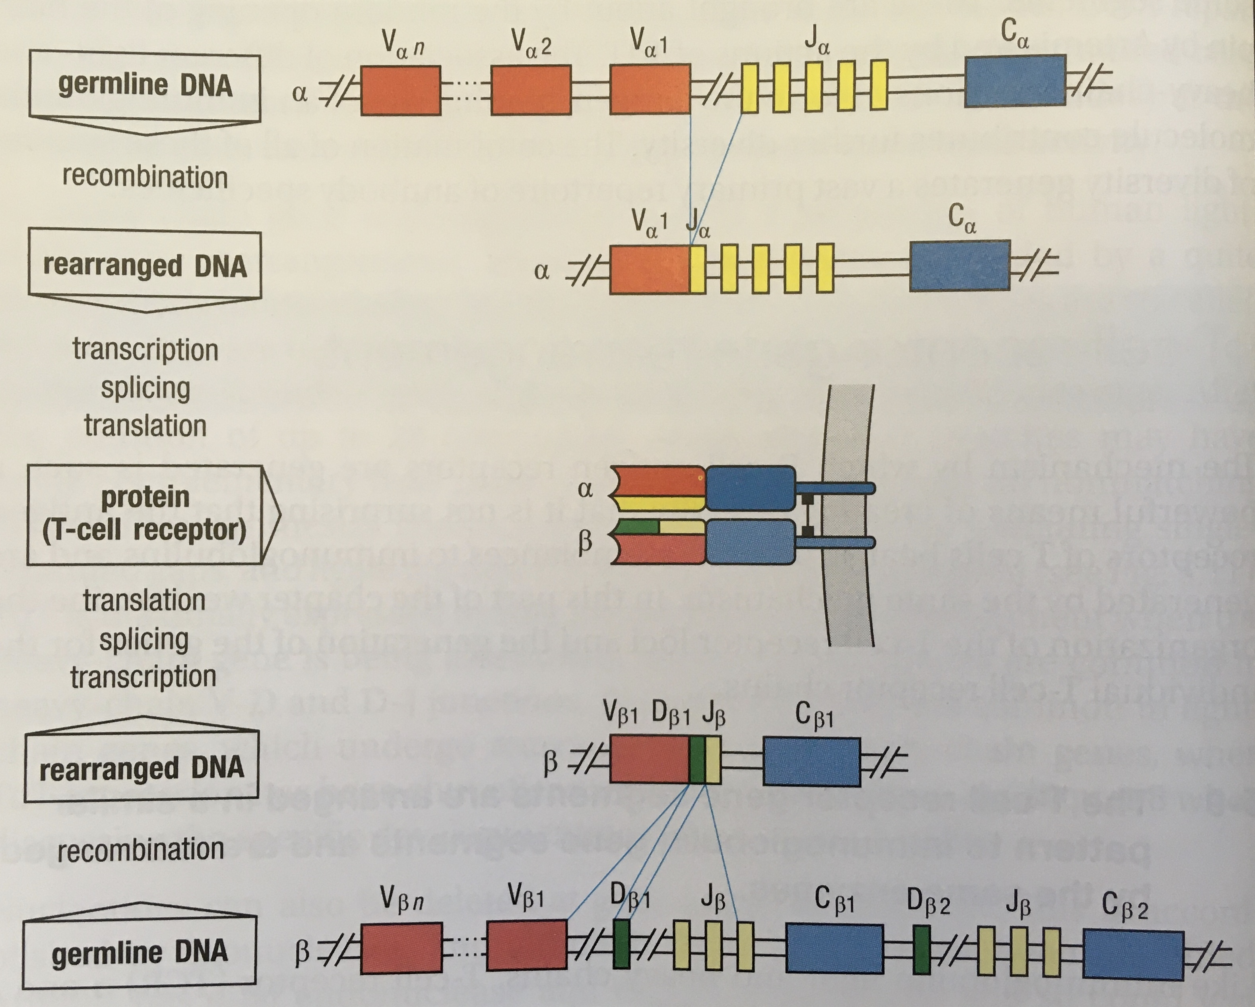
T-cell receptors are generated by random genetic recombination
Total diversity: ~10¹⁸
Immunobiology 9th Edition, Garland Science (2017)
Immunobiology 9th Edition, Garland Science (2017)
Notes:
Each T-cell carries a single TCR with two chains, alpha and beta. The genes encoding the alpha and beta chains are generated through recombination between VDJ modules and insertion/deletion of nucleotides at their junction.
This leads to a pool of 10¹⁸ possible TCRs.
Because of the random manner in which TCRs are generated, most will function inappropriately, either because they fail to bind MHC molecules or because they bind self-antigens (leading to auto

Slide 4
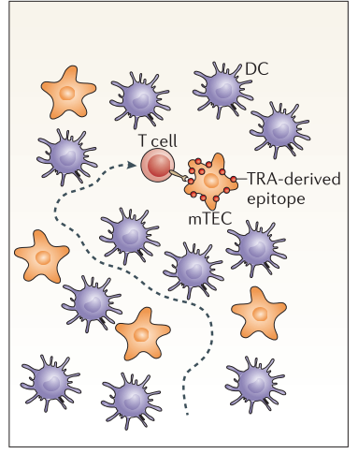
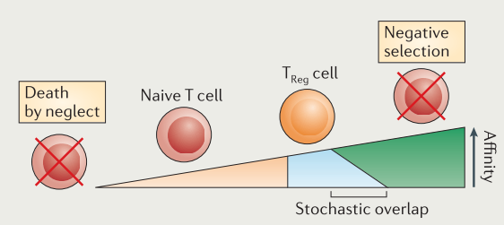
T-cells are subject to negative and positive selection in the thymus
TRA: tissue-restricted antigen
Klein et al, Nature Reviews Immunology (2014)
Notes:
The thymus is the training ground for the adaptive immune system. It contains a repertoire of antigen-presenting cells that interact with ‘candidate’ T-cells and thereby select for T-cells carrying TCRs that are both functional and self-tolerant.
90% of T-cells generated in the thymus are eliminated in the initial round of selection because they bind with insufficient affinity to MHC molecules displayed on the cTEC surface. This prevents the production of non-functional T-cells.
….

Slide 5
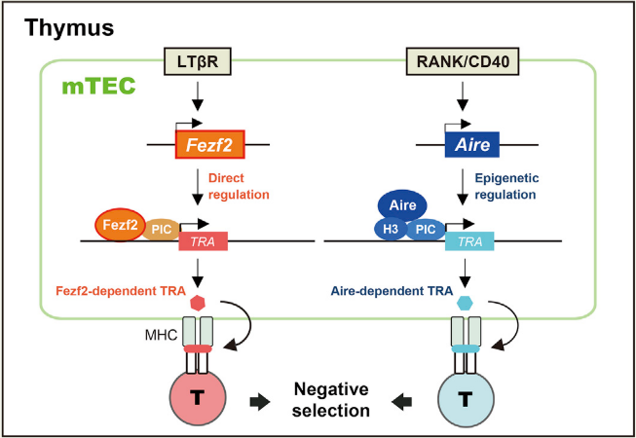
Promiscuous gene expression in medullary thymic epithelial cells
Takaba et al, Cell (2015)
Notes:
Medullary thymic epithelial cells are characterized by ‘promiscuous gene expression’, which refers to the expression of a repertoire of ‘tissue-restricted antigens’. TRAs are derived from proteins are are usually show tissue-specific expression.
During negative selection, T-cells that bind MHCs displaying TRAs are subject to apoptosis. This prevents the production of T-cells that recognize self.
Hence defects in promiscuous gene expression (e.g. AIRE loss of function) result in autoimmune reactions.

Slide 6
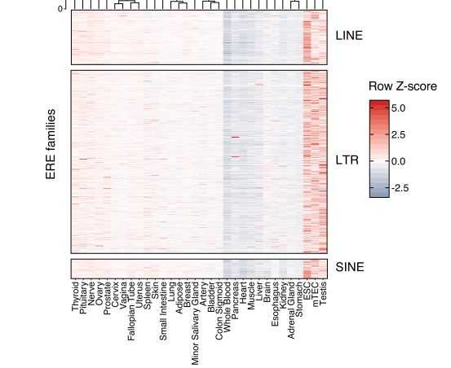
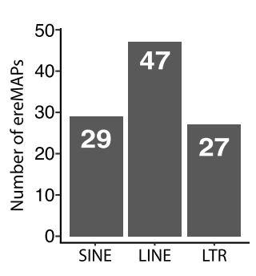
Widespread transposable element expression in human mTECs
mTEC: medullary thymic epithelial cell
Larouche et al, Genome Medicine (2020)
Notes:
In addition to promiscuous gene expression, mTECs exhibit widespread expression of retrotransposon transcripts, comparable to TE expression in testis and mTECs.
Mass spectrometry of MHC-1 associated peptides in a B-lymphoblastoid cell line shows that TEs are capable to generating antigens presented to T-cells. This could explain why TEs are expressed in mTECs, because the immune system must tolerate TE-derived anigens displayed on somatic cells.

Slide 7
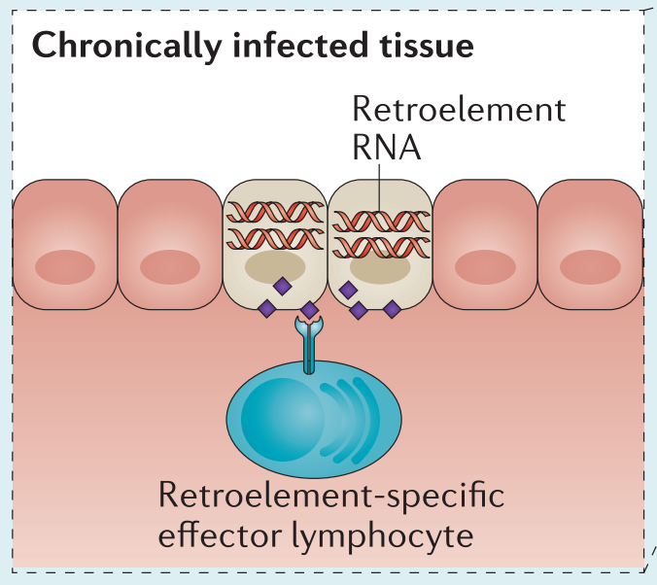
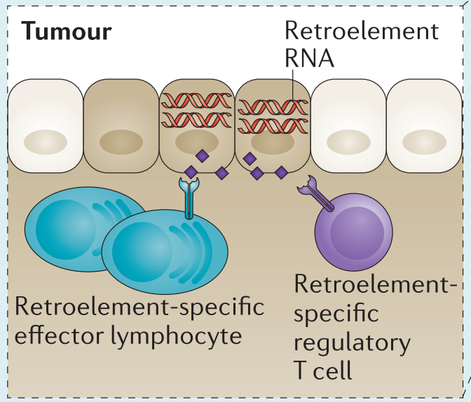
Balancing tolerance and reactivity to retroelements
Kassotis & Stoye, Nature Reviews Immunology 2016
Notes:
Transposons are interesting from an immune perspective because of the evolutionary relationship between ERVs and retroviruses.
On the one hand, T-cells must be tolerant to ERV-encoded proteins to some extent because select TEs are de-repressed in somatic cells.
However, T-cells cannot show complete tolerance because they must remain reactive to infective retroviruses, and to cells that show aberrant TE activation (e.g. tumor cells).
Rather than tolerance and reactivity being in conflict, they may be synergistic. In Young et al 2012, they show that negative selection of T-cells reactive to an ERV env protein enhances the avidity of T-cells reactive to a homologous retroviral env.

Slide 8
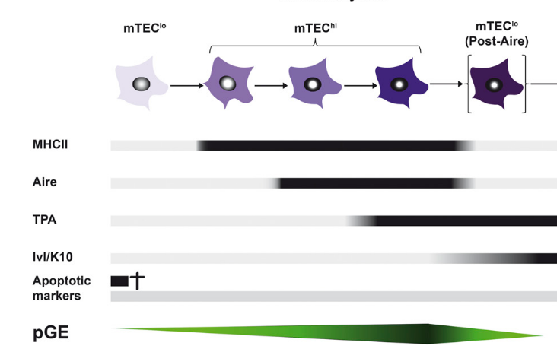
Is TE expression altered during mTEC maturation?
TE: transposable element; mTEC: medullary thymic epithelial cell
Michel et al, Journal of Immunology (2017)

Slide 9
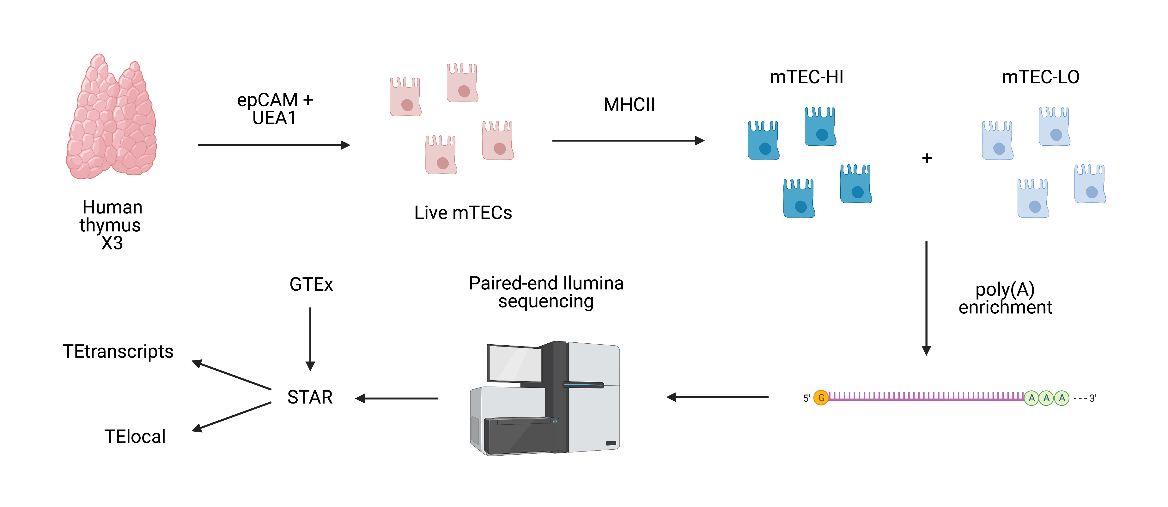
Is TE expression altered during mTEC maturation?
TE: transposable element; mTEC: medullary thymic epithelial cell
BioRender

Slide 10
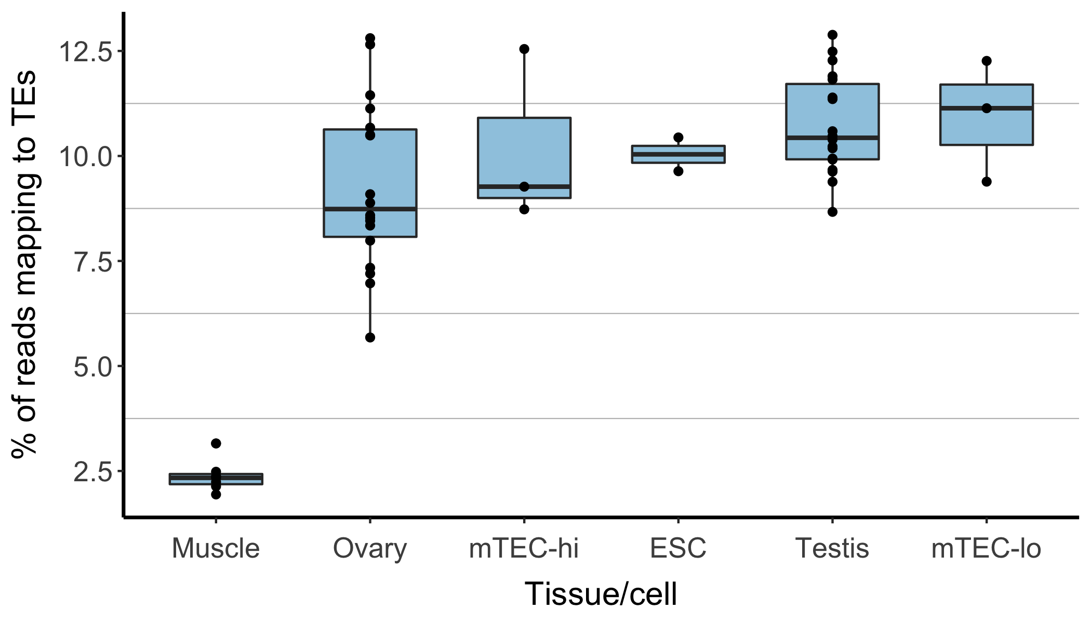
Overall TE abundance across tissues

Slide 11
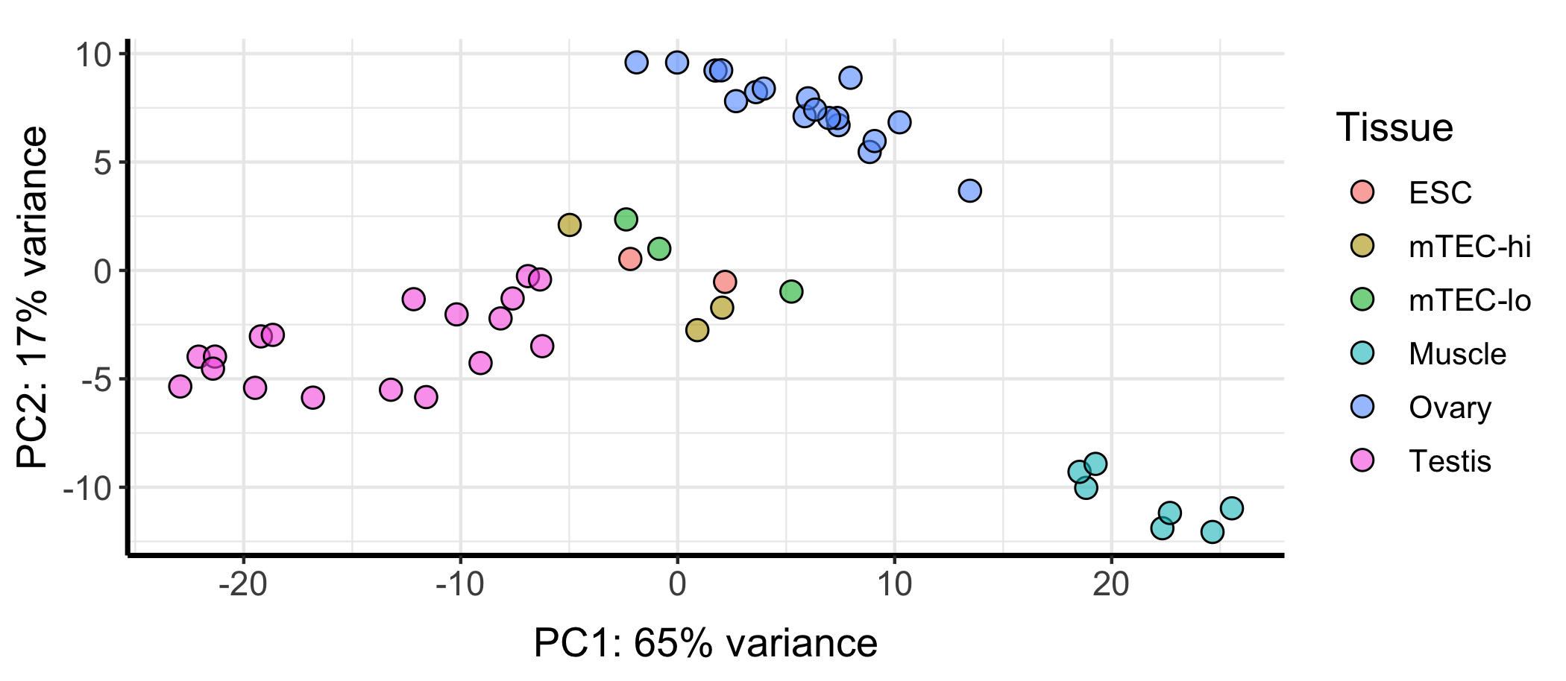
TE transcripts: PCA

Slide 12
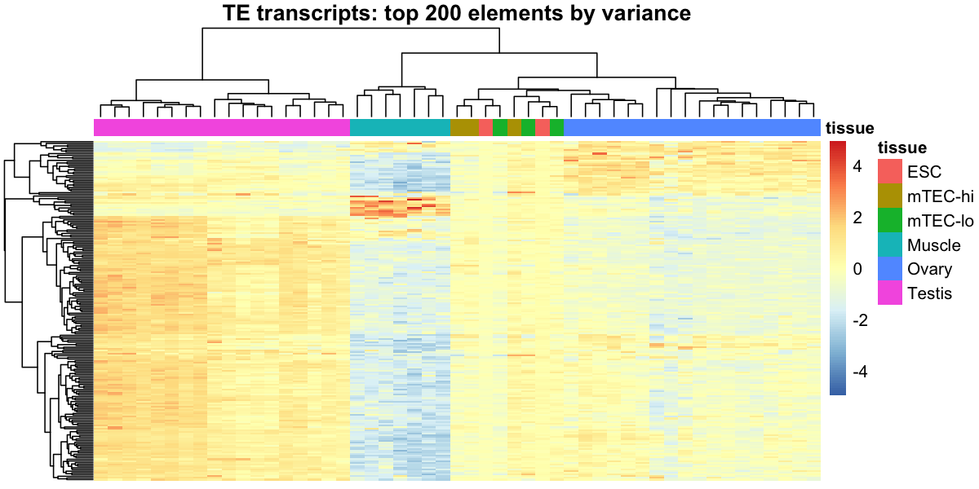
TE transcripts: top 200 elements by variance
Tissue
Z-score

Slide 13
TE transcripts: top 200 elements by variance
Tissue
Z-score

Slide 14
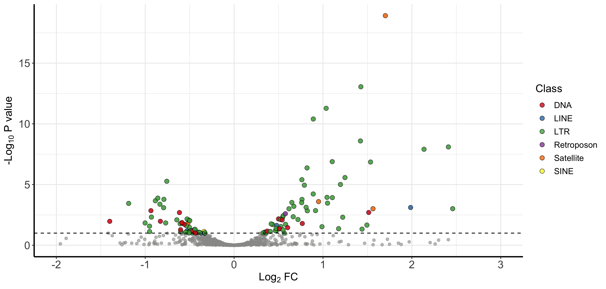
TE transcripts: mTEC-HI vs -LO

Slide 15
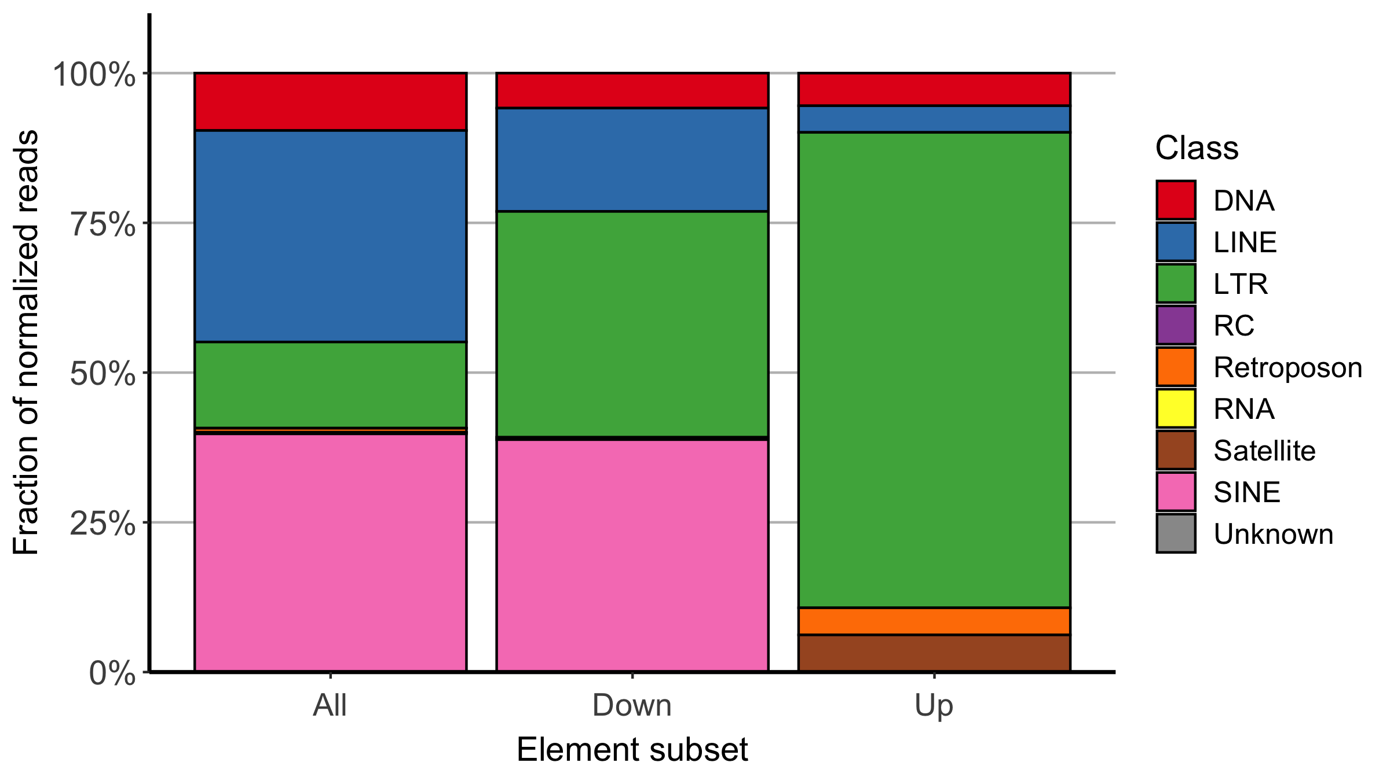
TE transcripts: read distributions in mTEC-HI
Chi-square test p-value:
2.2x10⁻¹⁶

Slide 16
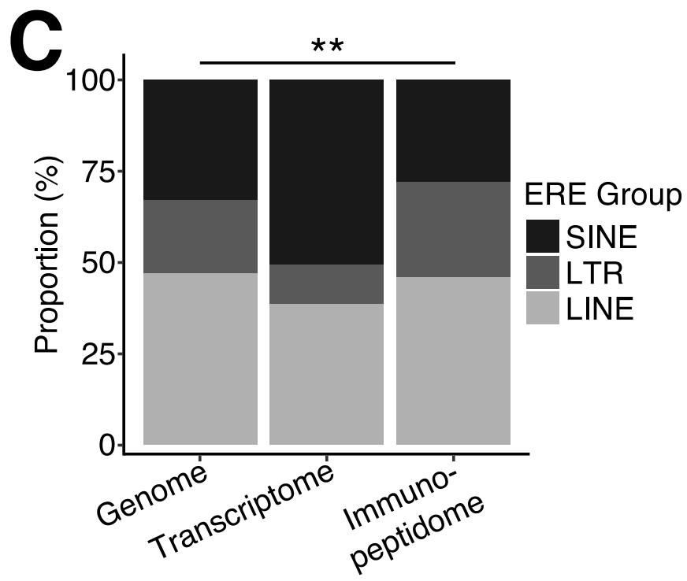
LTRs are preferentially translated over other retroelement classes
Larouche et al, Genome Medicine (2020)

Slide 17
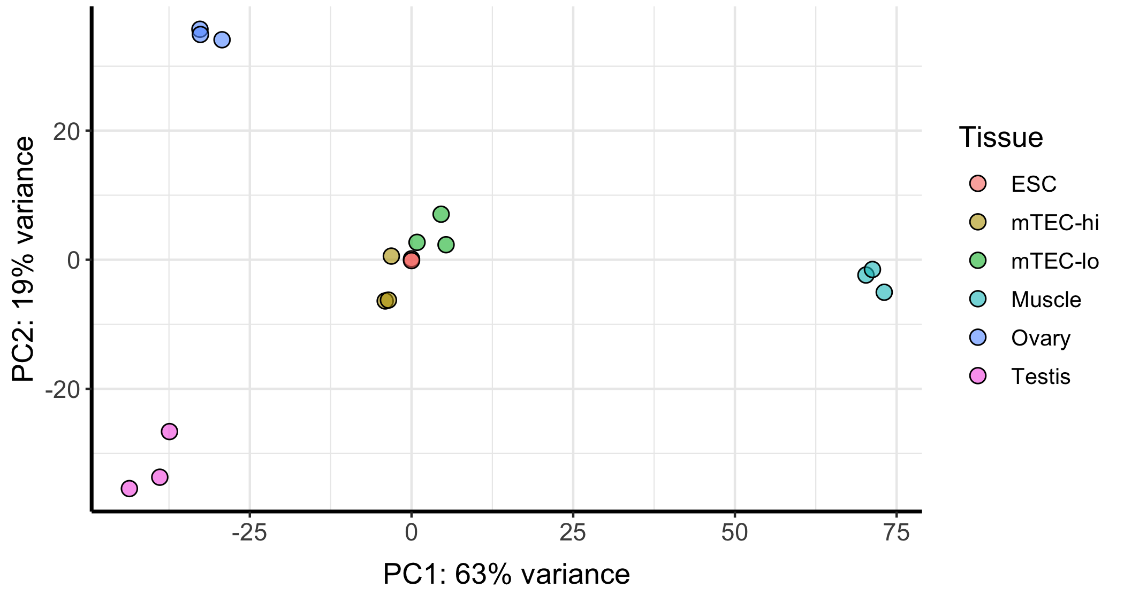
TE local: PCA

Slide 18
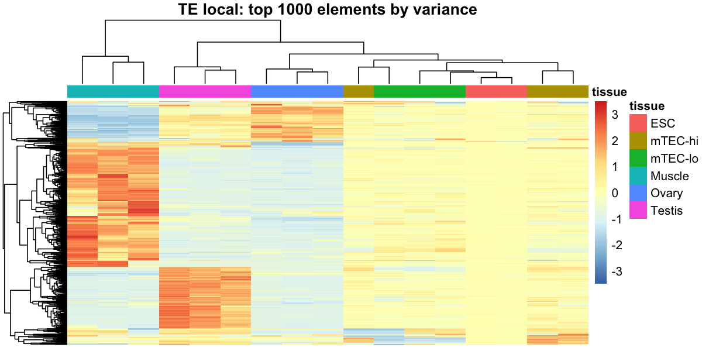
TE local: top 1000 loci by variance
Tissue
Z-score

Slide 19
TE local: top 1000 loci by variance
Tissue
Z-score

Slide 20
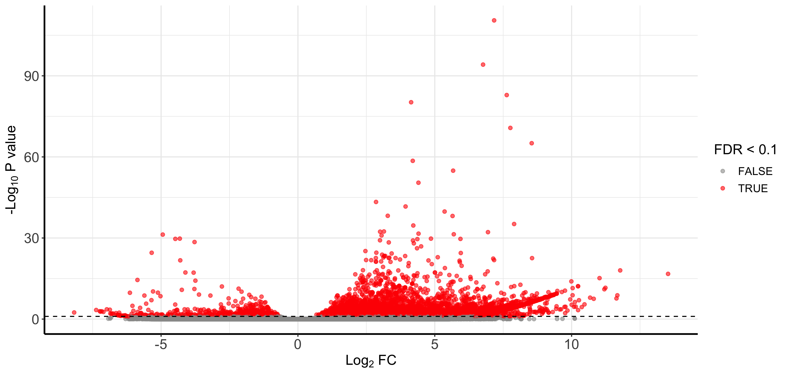
TE local: mTEC-HI vs -LO

Slide 21
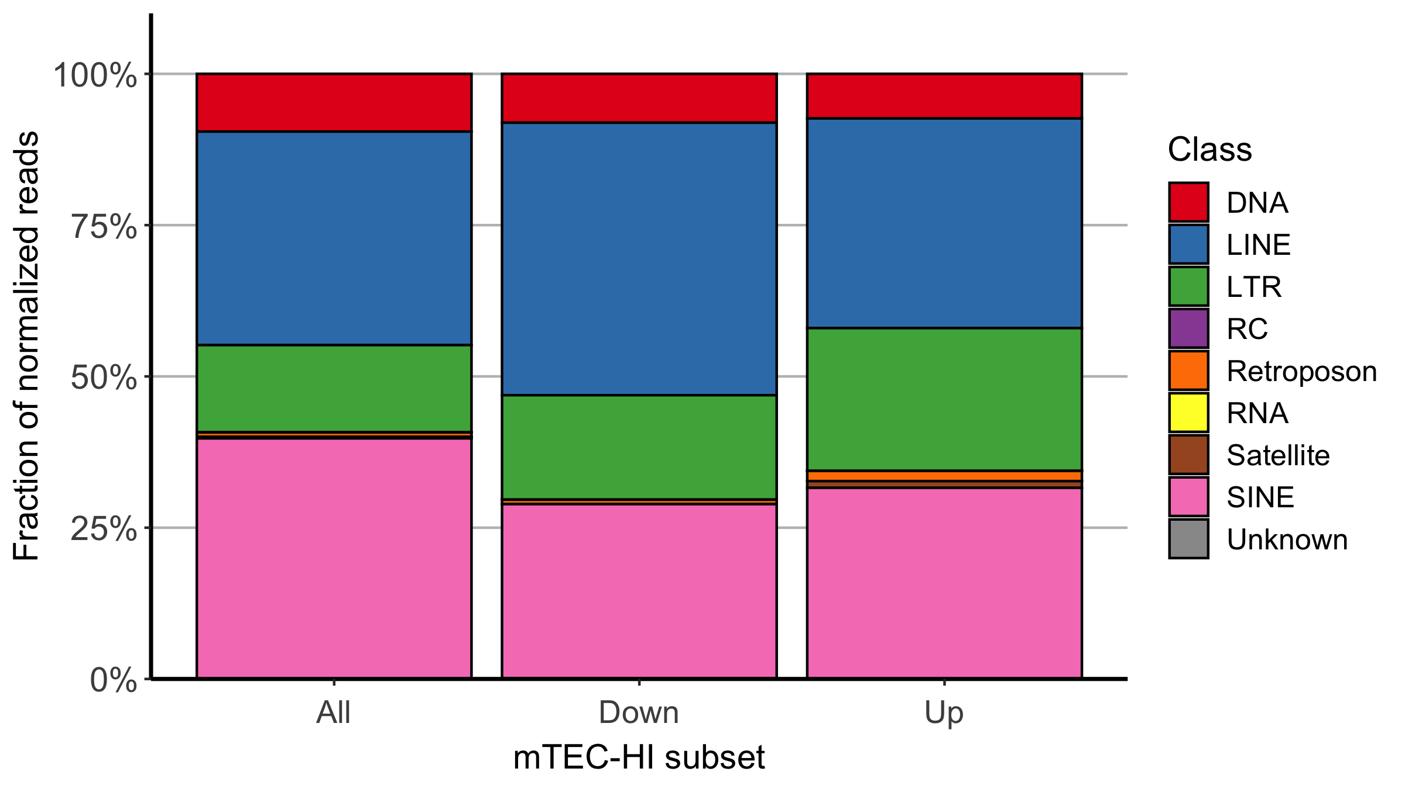
TE local: read distributions in mTEC-HI
Chi-square test p-value:
0.93
Locus subset

Slide 22
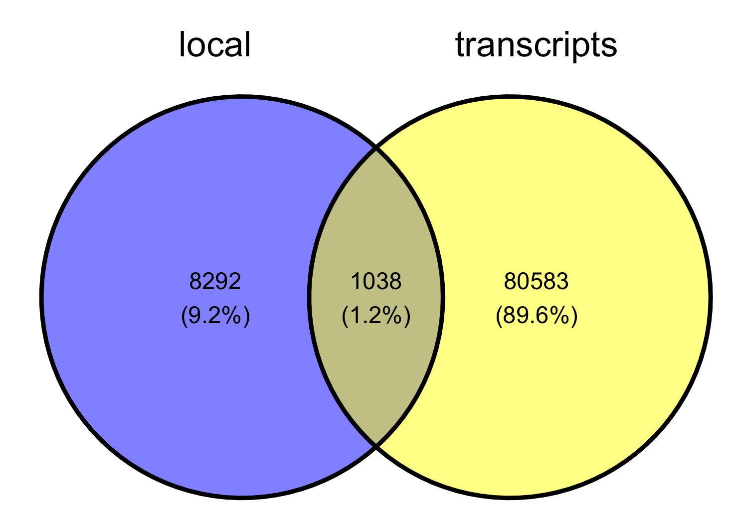
TE transcripts and local compared

Slide 23
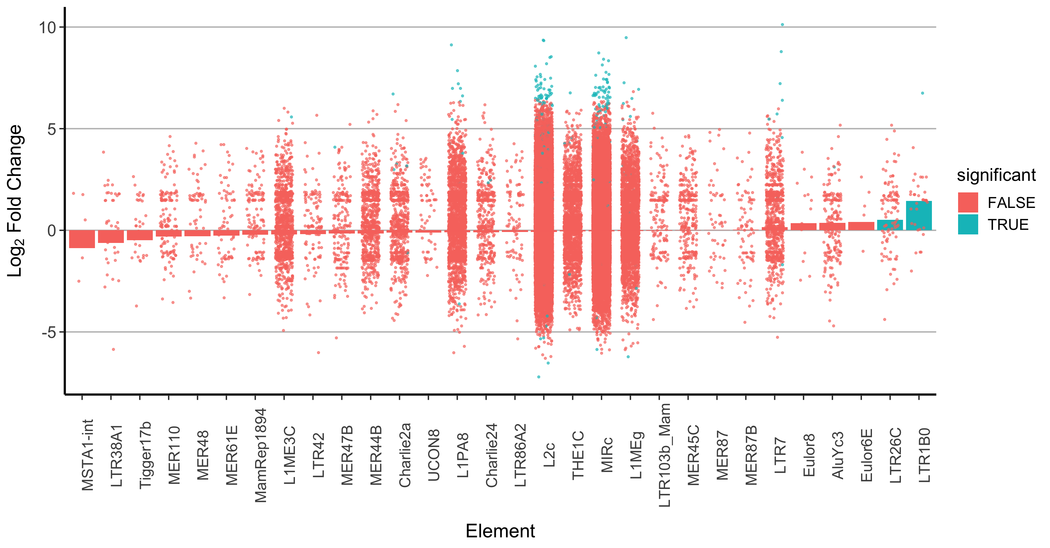
TE transcripts and local compared

Slide 24
Summary and future questions
mTEC-HI and mTEC-LO cells exhibit overall similar expression of transposable elements, but specific TEs may be differentially regulated during mTEC maturation.
What is the mechanism by which widespread TE expression in mTECs is induced?
Do mTECs express small RNAs mapping to TEs that might serve to restrict their integration?
To what extent are expressed TEs translated in mTECs to generate MHC-displayed antigens?
To what extent is expression of TEs necessary to establish self-tolerance?

